Slide 1



Interactive possessives
The teacher plays one of the children and a student plays the other. They each choose half of the objects. Then the teacher asks whether a given object belongs to him/her or to the student, addressing the student in the second person.
Example: “Is it your fish?” - “No, it isn't my fish. It's your fish.” Note: the scale belongs to everyone in every exercise - it's “our scale.”
Once the procedure is well understood, two students carry out this same activity together.
Safar 3

Slide 2
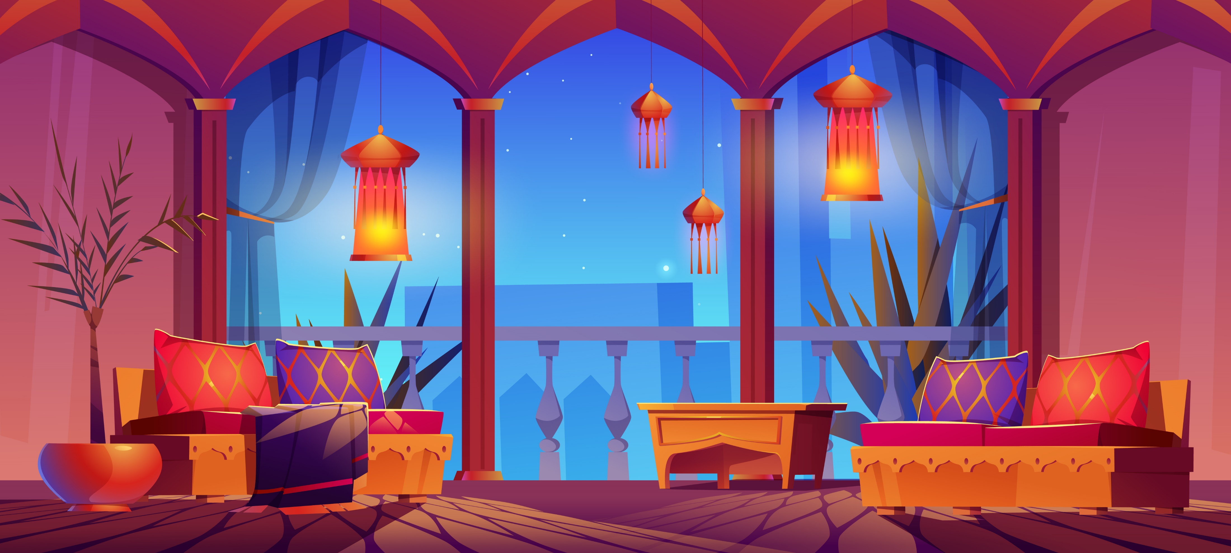


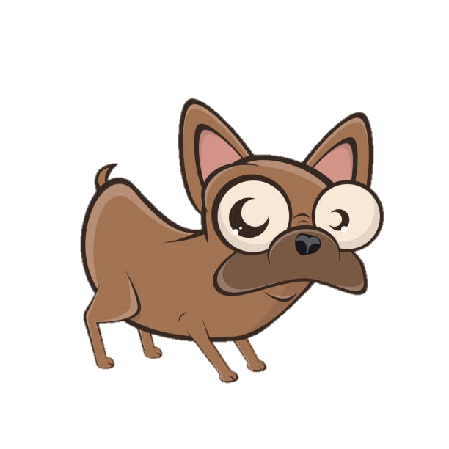





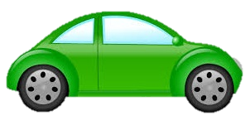
مِيزان
سَمَكة
سَلْمَى
سَلِيم
كُرة
طائِرة

Slide 3
Stop the slideshow
Safar 3

Slide 4
Student's name:
Idrîs
Student's name:
Mattia

Slide 5
The students keep the same objects and ask about their position: “Where is your dog? Where is my fish?” The teacher can move the objects around.
Safar 3

Slide 7
Second step: The man and the woman face each other, with objects around them. The objects to the right of the bed belong to the woman, and those to the left belong to the man. The teacher asks whether a given object belongs to the man or to the woman.
Example: “Is it his dog?” - “No, it isn't his dog, it's her dog.”

Slide 8
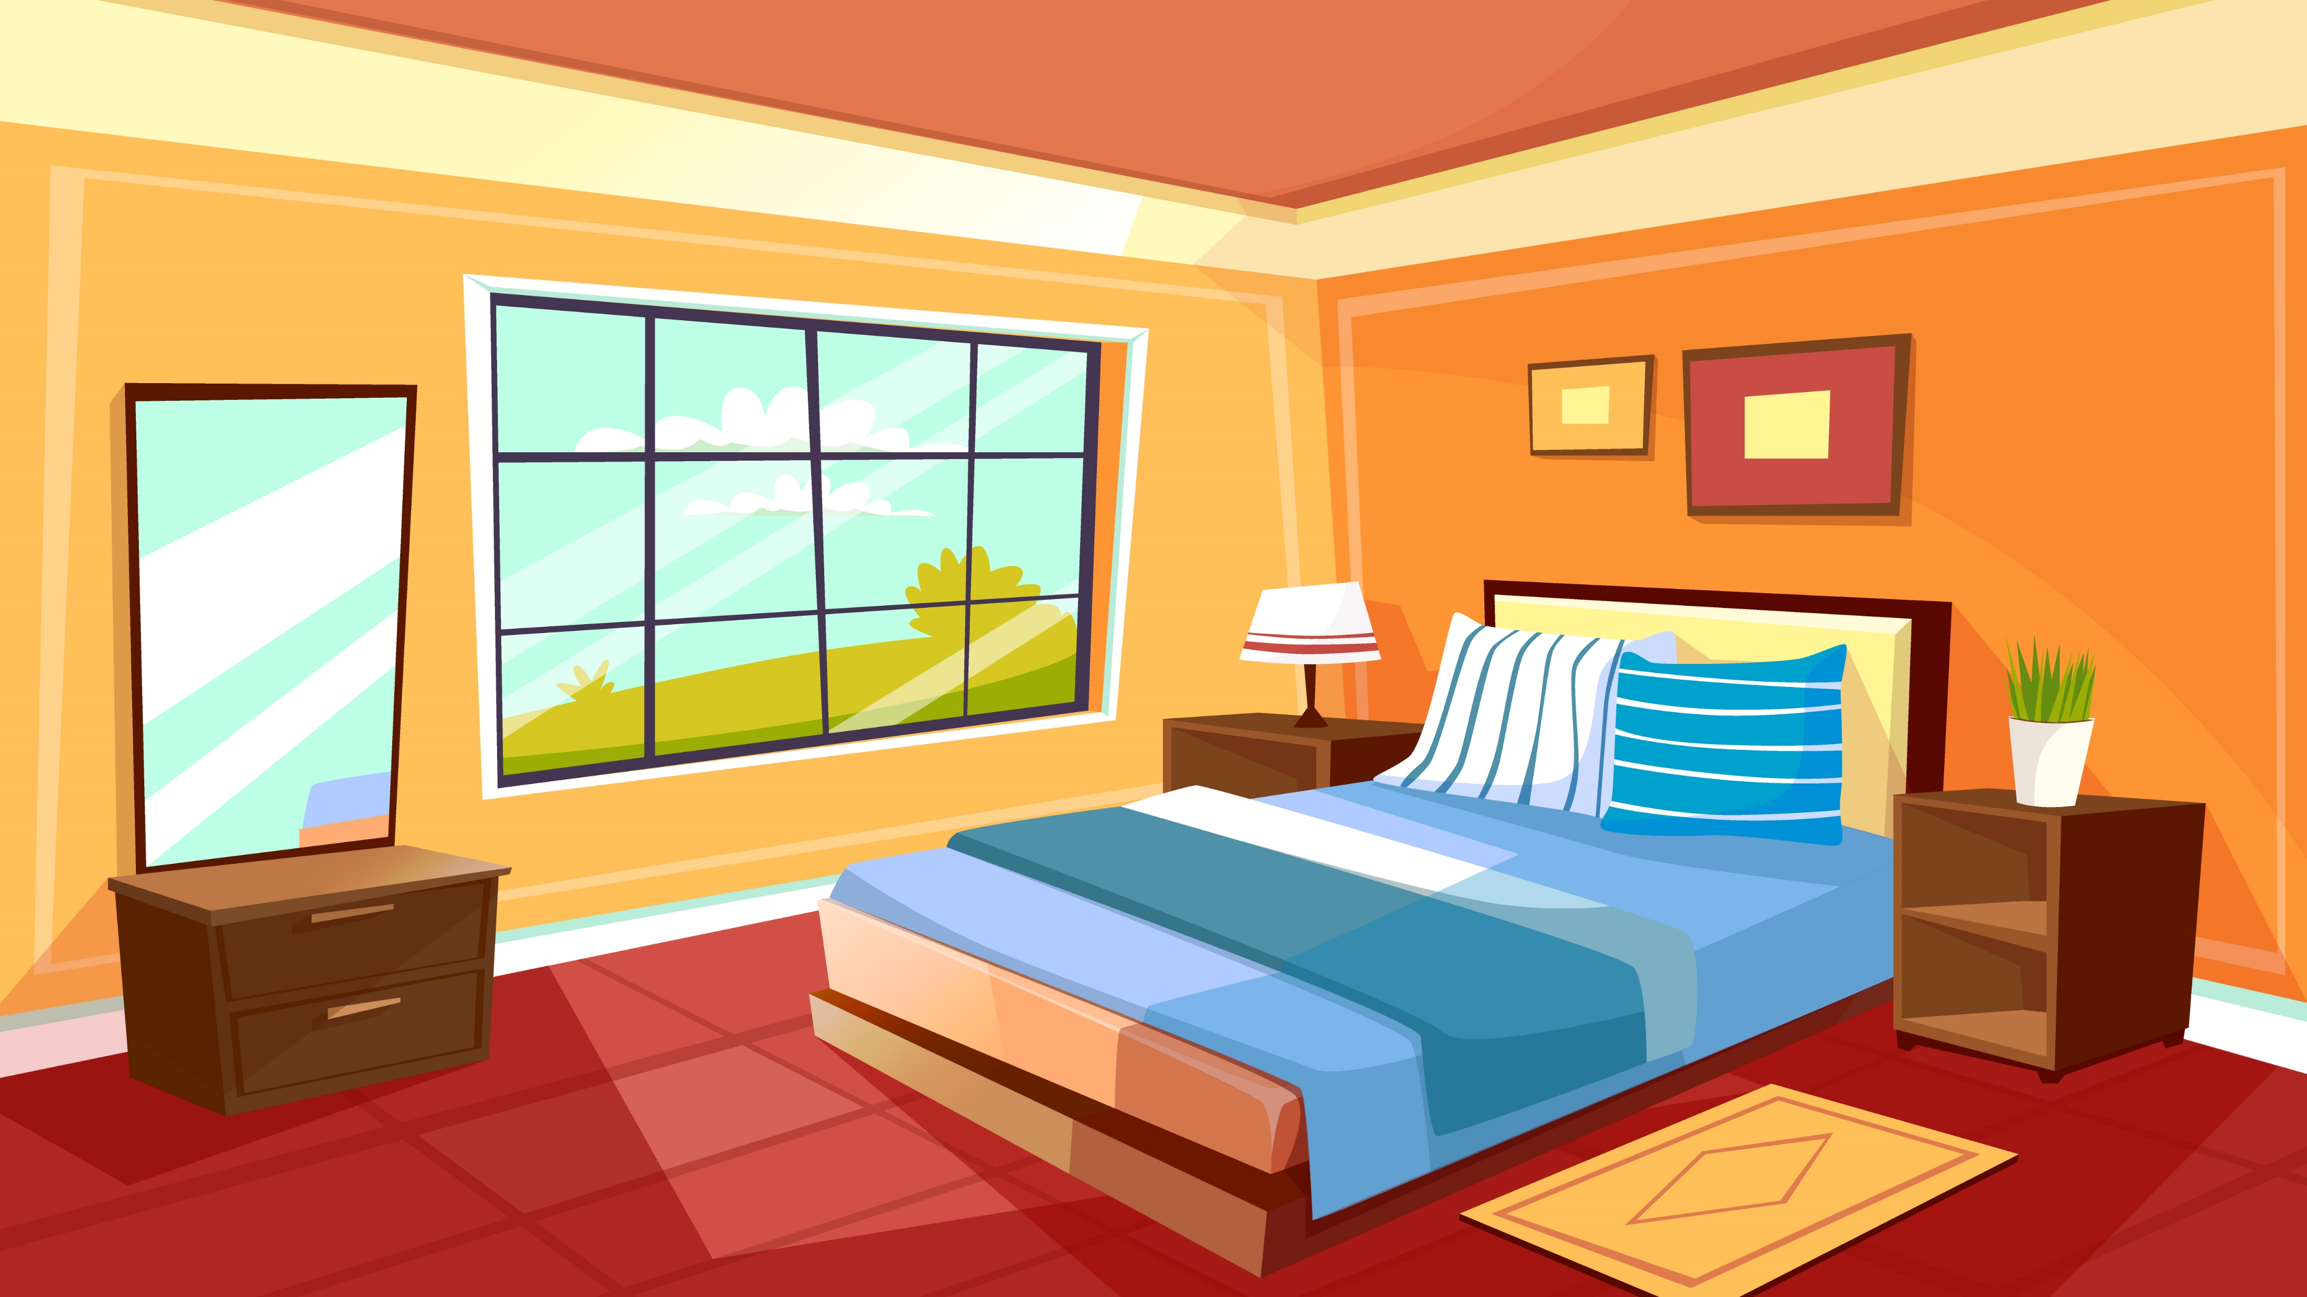

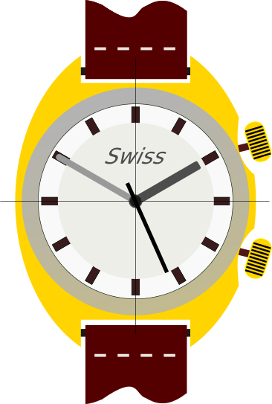









مِرْآة
نَبْتة
ساعة
مَحْمُول
صَحِيفة
خِزانة
مَكْتَب
مِفْتاح

Slide 10
You can also review the negation of nominal sentences by asking questions such as: “Is his dog under the bed?” Answer: “No, his dog isn't under the bed!”
Ask where the characters' objects are. Example: “Where is the man's newspaper?” Answer: “His newspaper is on the table.”

Slide 11
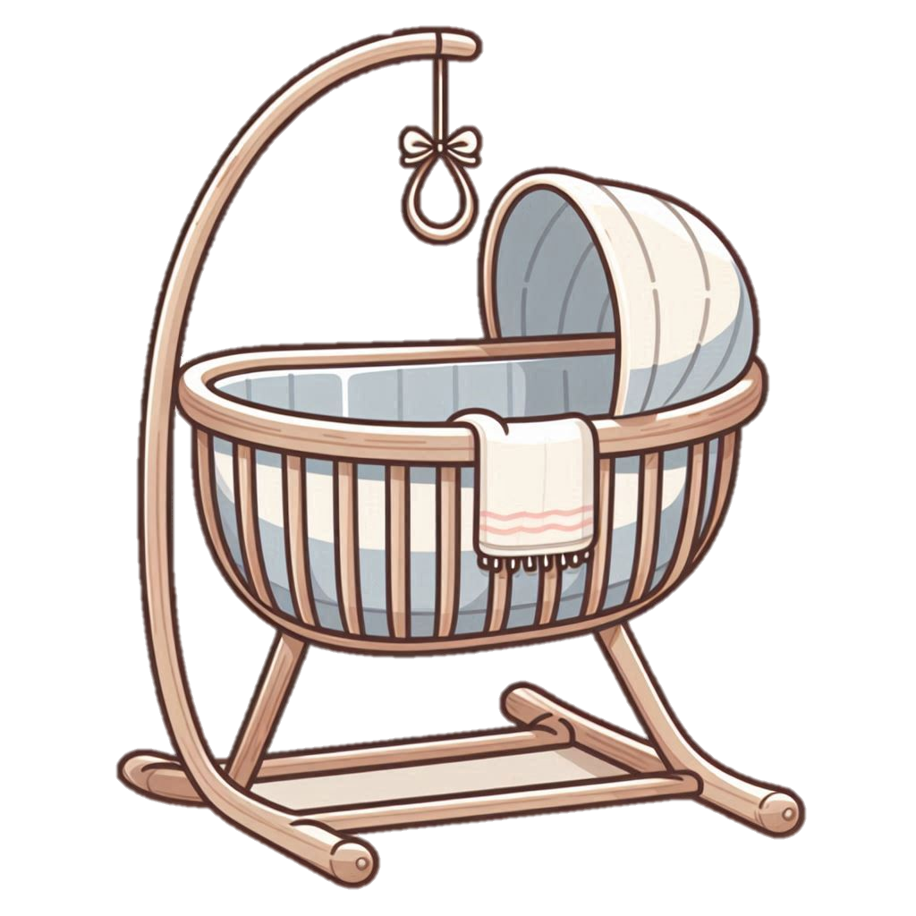




مِحْفَظة
زُجاجة
مَهْد
قَمِيص

Slide 12
The children argue about who the objects belong to. One student defends the girl, the other defends the boy.
The teacher asks, for example: “Whose dog is this?” - “It's his dog, it isn't her dog.” - “No, but...”

Slide 13
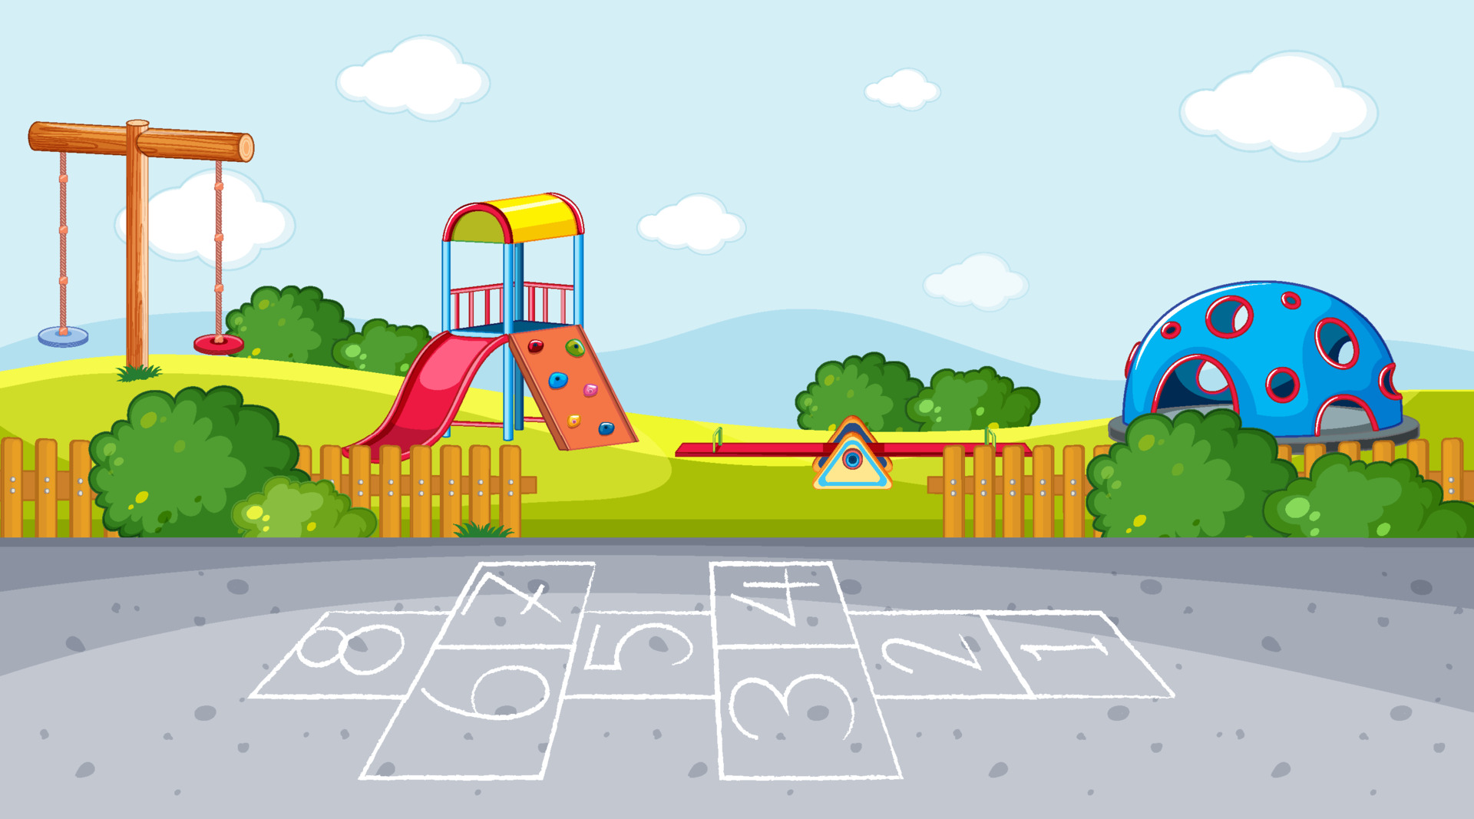

Slide 14
Part Two

Slide 15
Each student identifies with a character. One of them declares that a given object belongs to a certain person; they may attribute it to themselves, to you, or to someone else. Note: the scale belongs to everyone - it's “our scale.”
The next student disagrees: no, it isn't my/your/his book; it's so-and-so's book. Objective: use the second- and third-person attached pronouns.

Slide 16
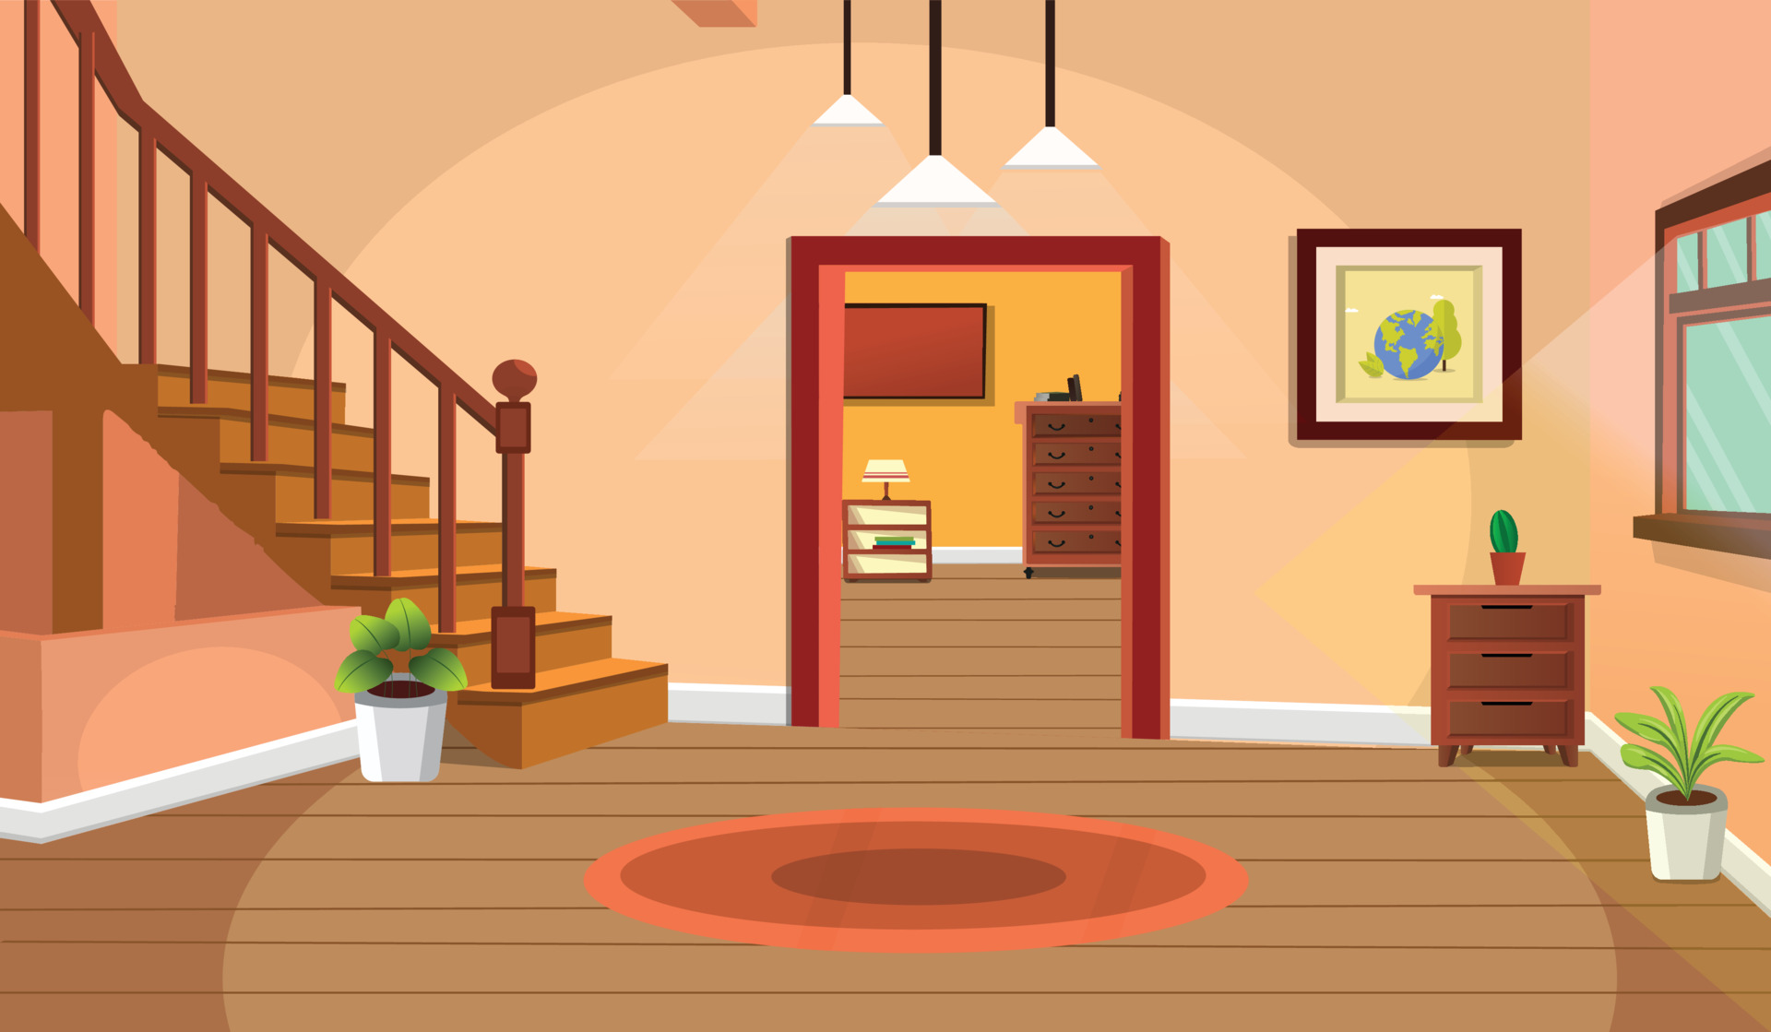
تصْعَدُ العائِلة إلى العِلِّيّة.

Slide 17
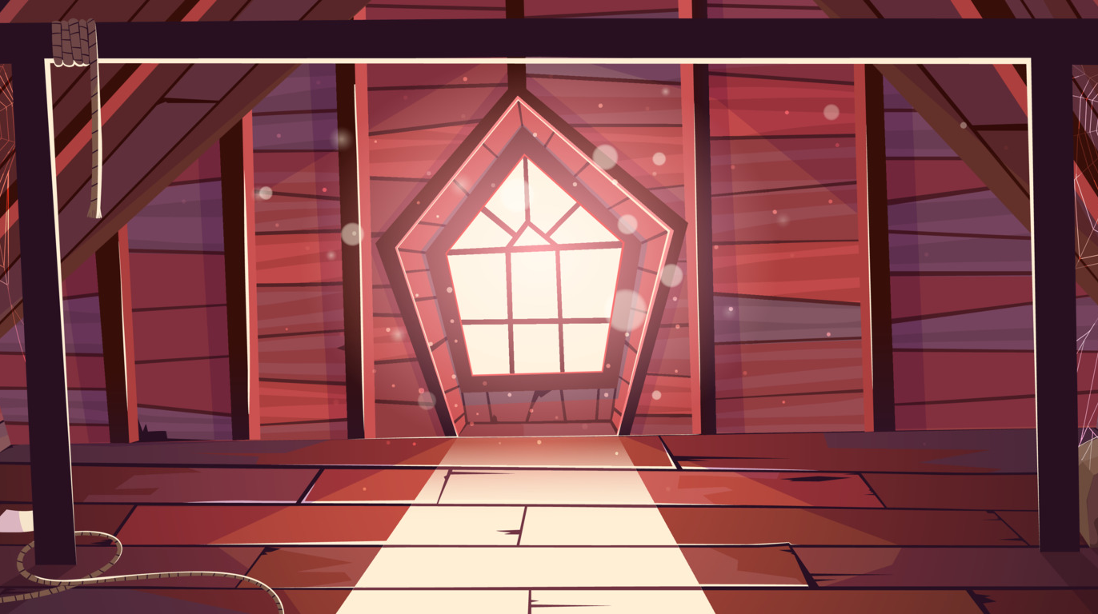
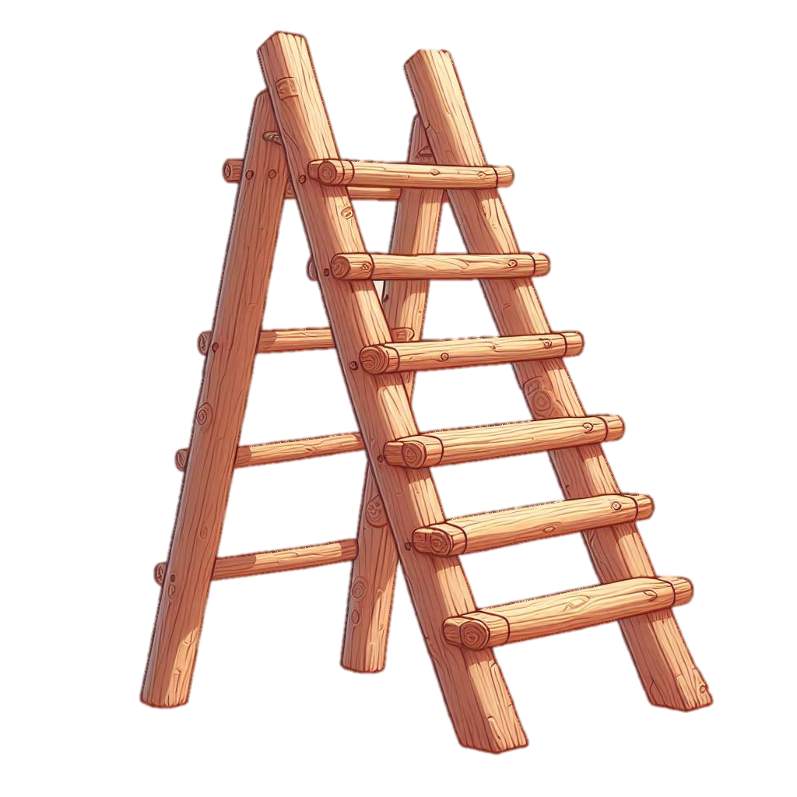


سُلّام
لَوْحة
قَمِيص
مِصْباح
زُجاجة
مَهْد
مِيزان
مِحْفَظة

