Slide 1


Objectives: Start learning demonstratives and interrogatives; learn vocabulary and pronunciation.
Teaching sequence:
Scroll through the slideshow to the next teaching sequence.
The teacher names the objects and asks the students to repeat.
“Hādhā jamal,” etc.

Slide 2
هٰذَا = This (masc.)
هٰذِهِ = This (fem.)
ما = What is…?
في = In
جَنْبَ = Beside

Slide 3
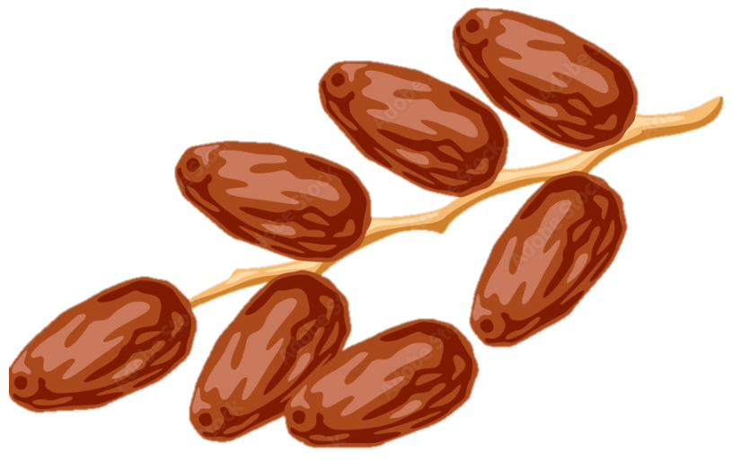
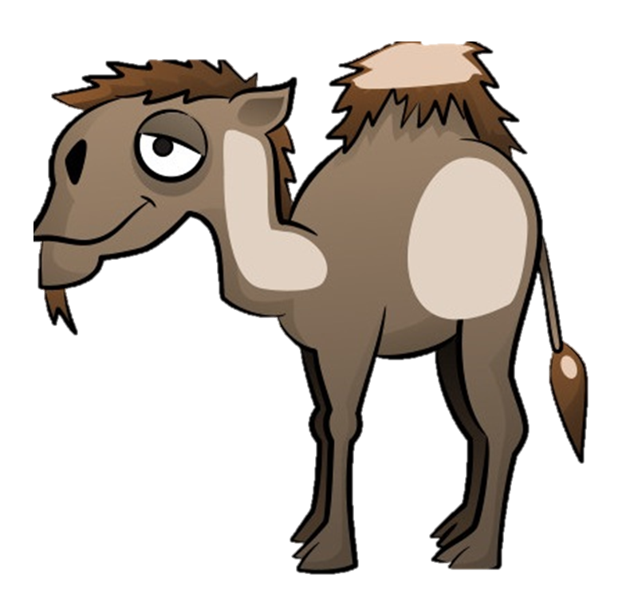



الرَّجُل في الصَّحْراء
الوَلَد جَنْبَ الرَجُل
نَخْلة
تَمْر
رَجُل
وَلَد
جَمَل

Slide 4
Teaching sequence :
Stop the slideshow and ask questions about the pictures. Example :
- Mā hādhā?
- Ayna al-jamal?

Slide 7

Teaching sequence:
The teacher asks the students questions using the items below.
The students take turns asking each other questions.
أَيْنَ = Where
هَلْ = Is…?
نَعَم = Yes
لَا = No
Example:
Hali-l-jamal janba n-nakhla?

Slide 11
Teaching sequence:
Resume the slideshow.

Slide 12
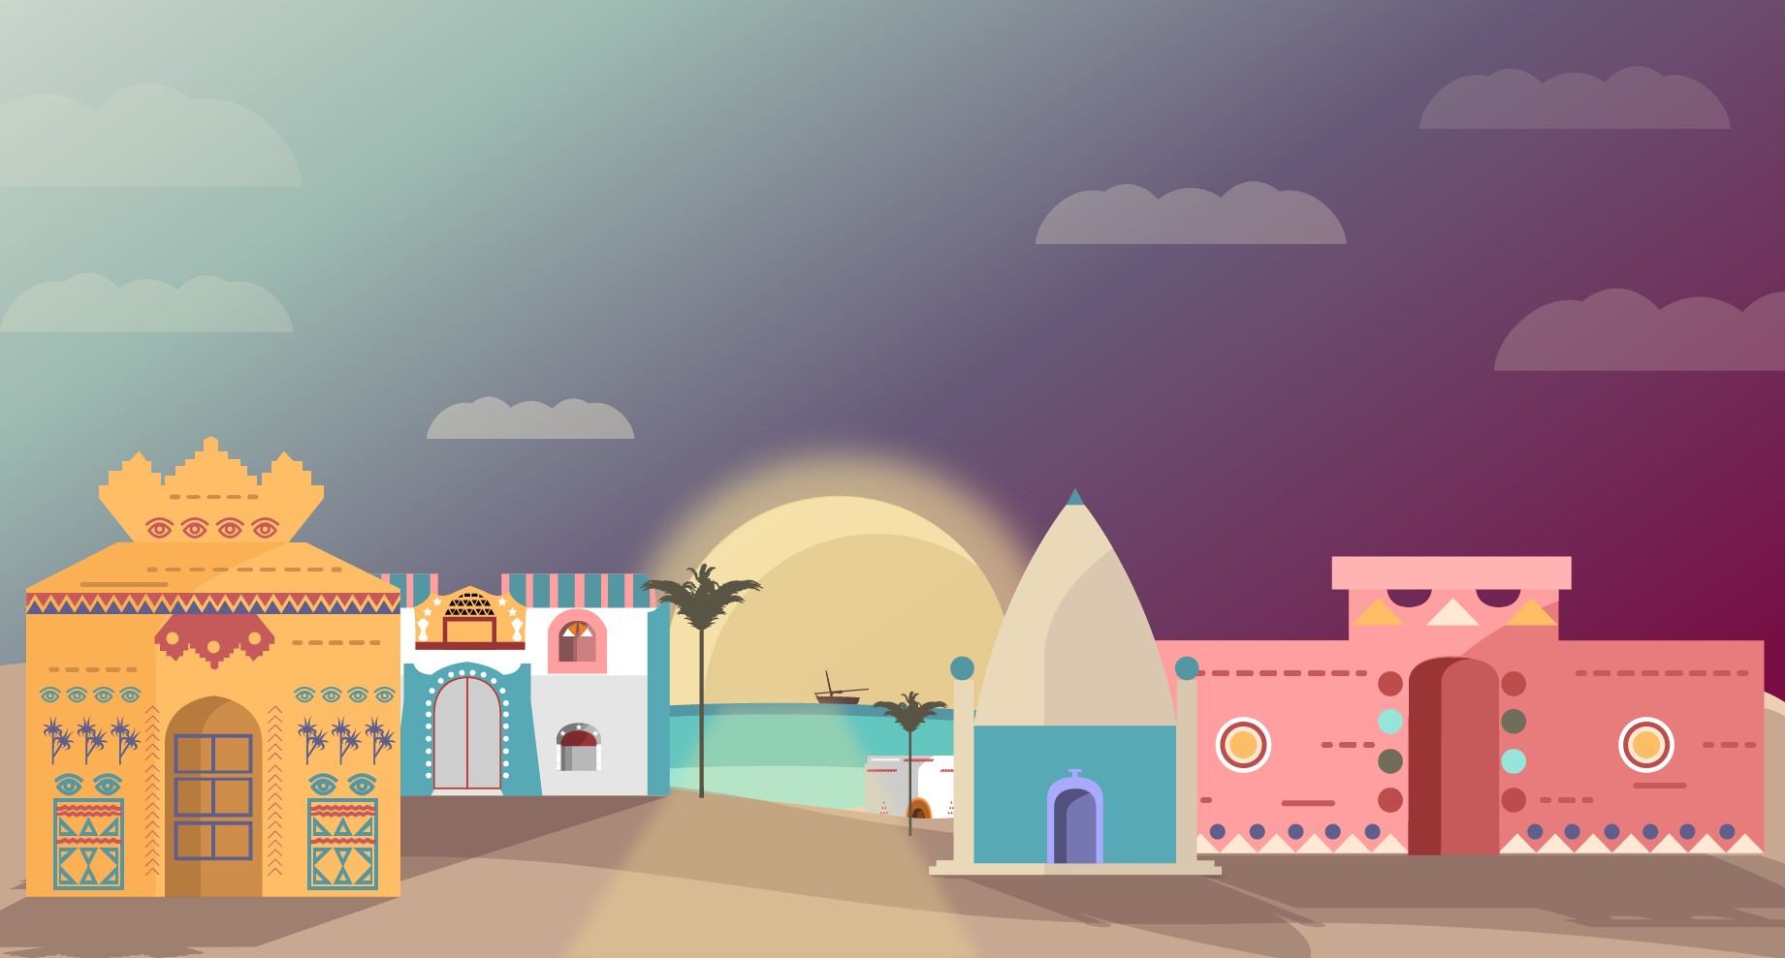




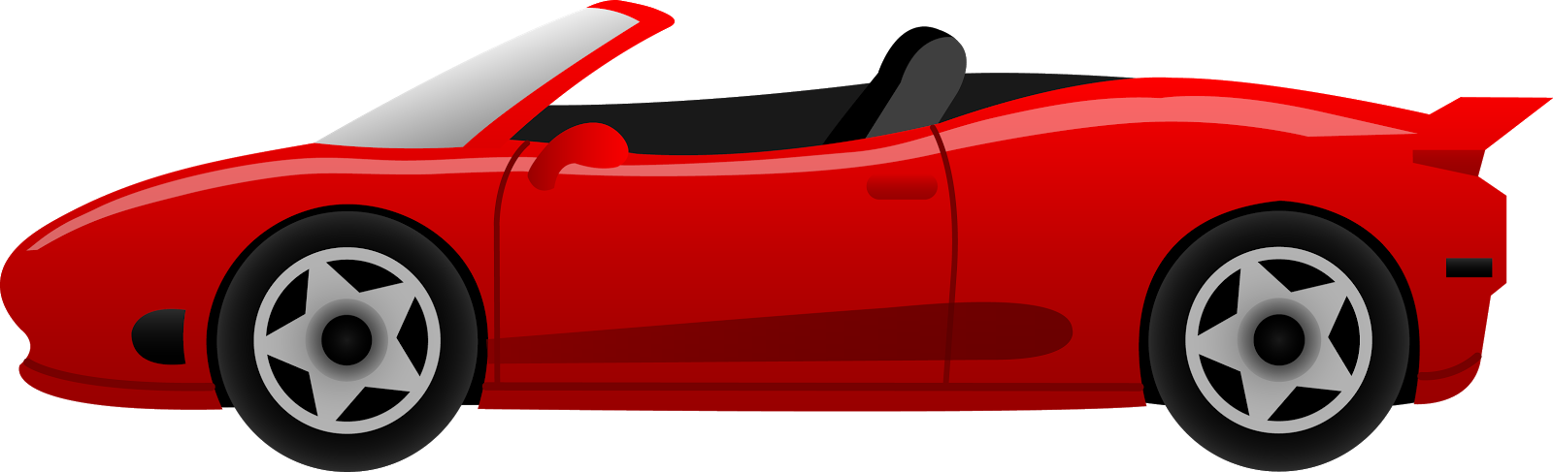

المَرْأَة في المَدِينة
شَجَرة
بَيْت
بِنْت
اِمْرَأَة
سَيّارة
حِمار
زَيْتُون

Slide 13
الزَيْتُون جَنْبَ المَرْأَة
البِنْت عَلَى السيّارة

Slide 14
Teaching sequence :
Pause the slideshow.
The teacher asks the students questions using the items below.
The students work in pairs or groups of three and ask each other questions.
Example:
Ayna l-bint?
Hali-l-bint janba n-nakhla?
Lâ, al-bint ‘alâ-l-himâr.

Slide 16


Slide 19

Answer
أَيْنَ الرَّجُل؟
أَيْنَ المَرْأَة؟
أَيْنَ البِنْت؟
أَيْنَ الوَلَد؟
أَيْنَ الزَيْتُون؟

Slide 20
Supplement to Part One (for review)
Teaching sequence :
Ask questions (teacher, then students).

Slide 22

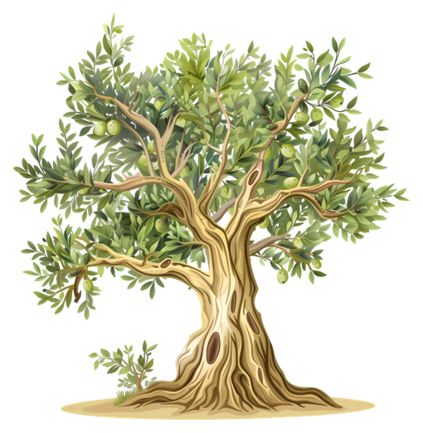

Slide 23
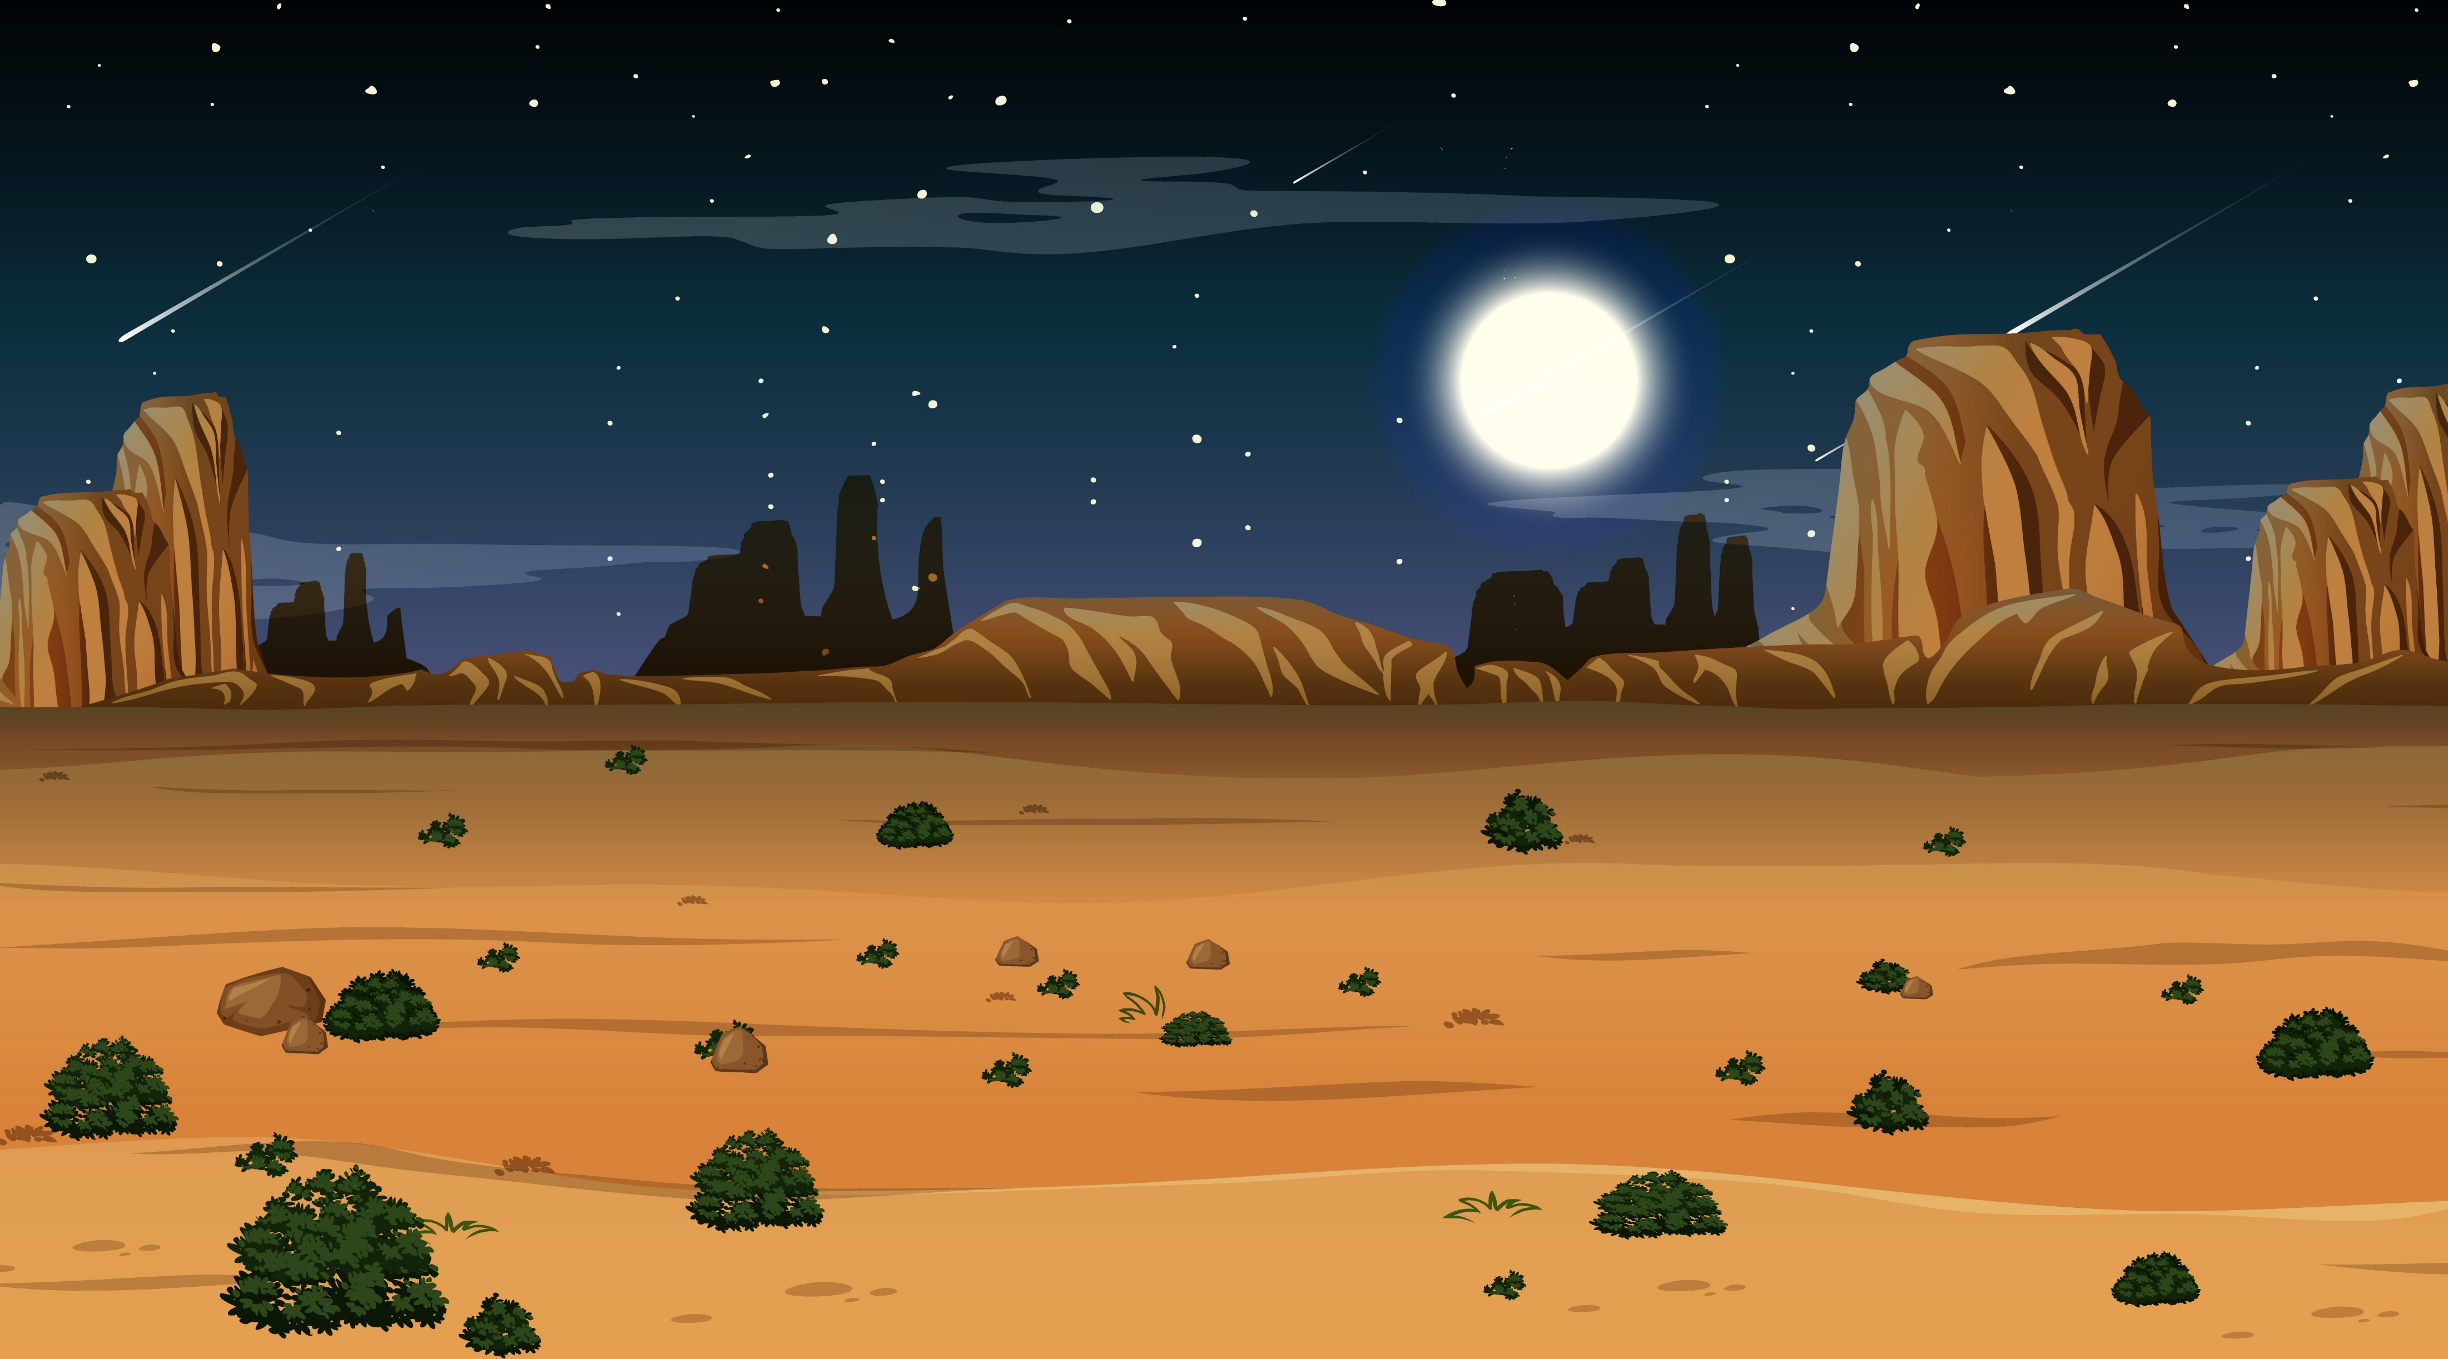
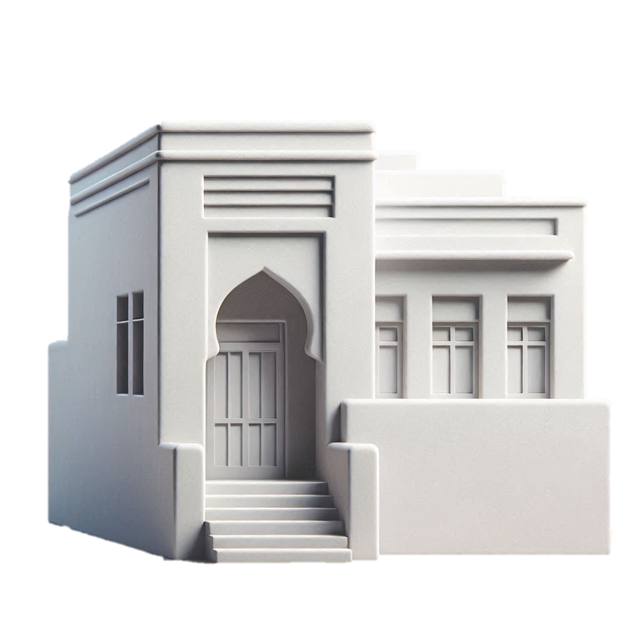

Slide 24
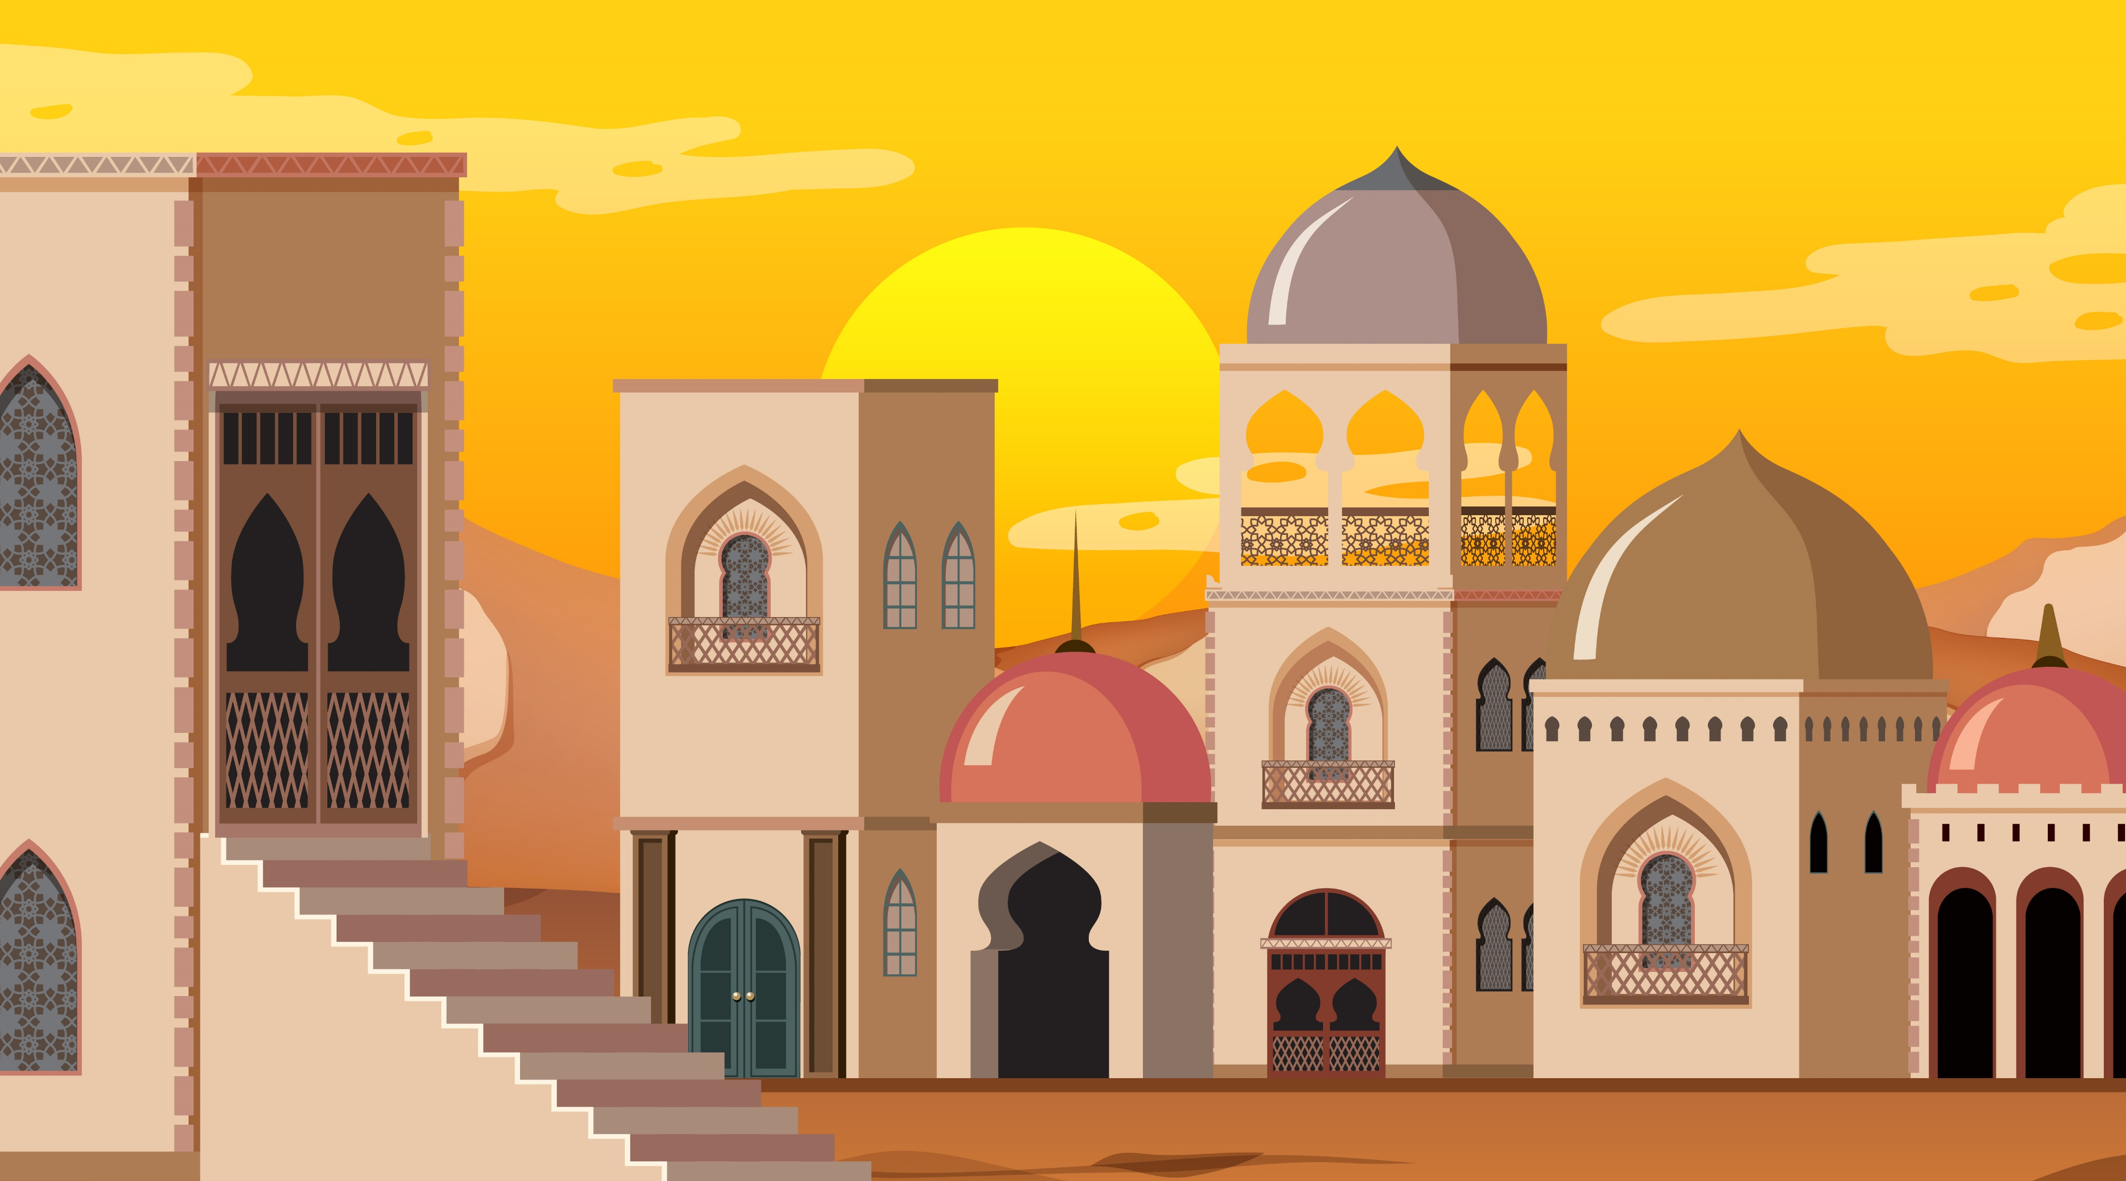

Slide 25
Second part
Objectives :
Practise laysa; learn vocabulary and pronunciation.
Teaching sequence:
Ask questions (teacher, then students) as in the examples provided, and answer using laysa where necessary.

Slide 26
Note
عَلَى يَمِين | On the right
عَلَى شِمال | On the left

Slide 27



الرِّسالة على المائِدة
طَيْر
رِسالة
مُراد
مائِدة

Slide 28


Slide 29
Note
عَلَى ‘Alâ : on
تَحْتَTaḥta : under
أَمامَAmâma : in front of
خَلْفَKhalfa : behind

Slide 30


مُنَى

Slide 31



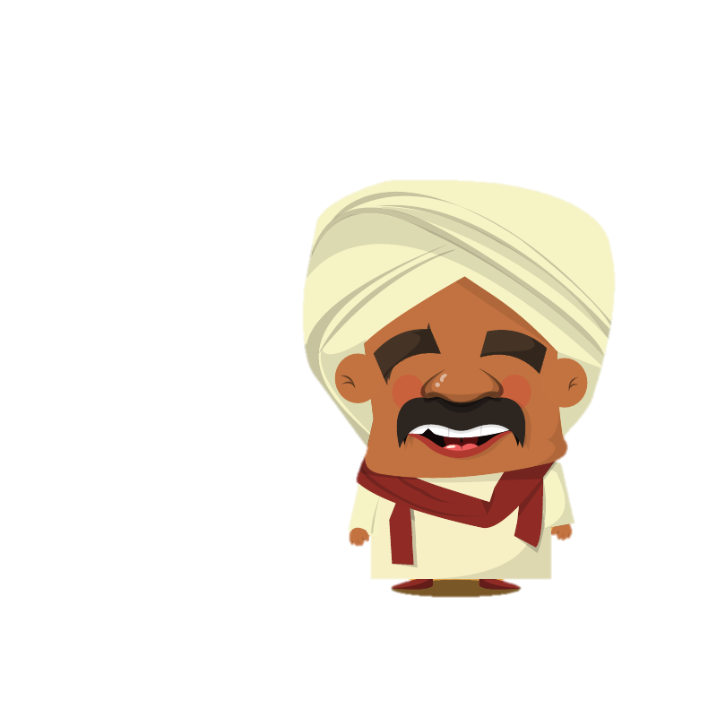


Big | كَبِير | Small | صَغِير
شَجَرة

Slide 32





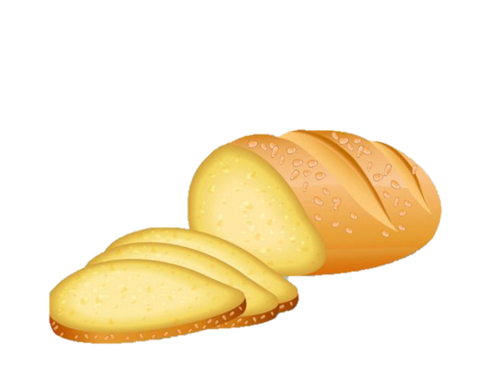



Near | قَرِيب | Far | بَعِيد
مُراد زَوْج مُنَى
مُنَى زَوْجَة مُراد
New | جَدِيد | Old | قَدِيم

Slide 33

أَهْلًا يا حَبِيبَتِي.
بِخَيْر الحَمْدُ لله.
مَرْحَبًا يا حَبِيبِي.
كَيْفَ حالُكَ؟

Slide 34
Review

Slide 35
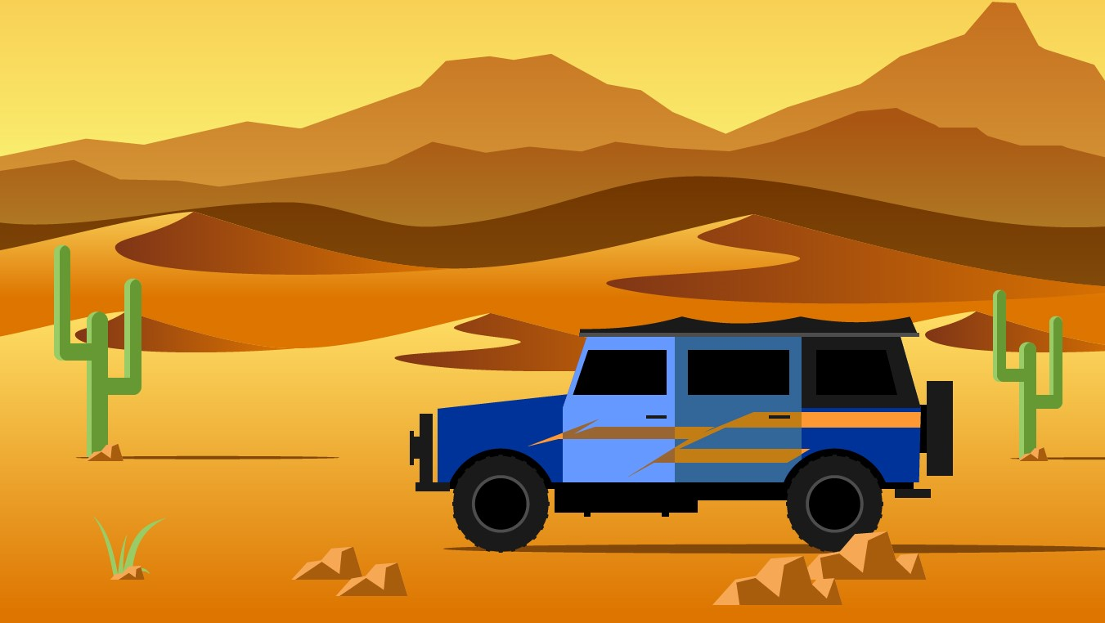




Slide 36





