Slide 1


Pedagogical thread: Move the characters around the picture and describe their actions using as many verbs as possible. Example: “The man leaves the house and goes to the office. He works a lot.”; “The man goes to the restaurant. He goes in. He eats falafel and drinks milk.” etc.
In a second stage, do the exercise in the dual and the plural. Important note: when the verb is placed before the subject, it stays in the singular. This point will be studied in detail in Unit 10.

Slide 2
Examples of verbs
شرِب ــَـ | To drink | أكَل ــُـ | To eat
نظَر ــُـ إلى | To look at | جلَس ــِـ | To sit down
يَدْعُو | To invoke, to call | يُصَلِّي | To pray
يَمْشِي | To walk | يَشْتَرِي | To buy

Slide 3








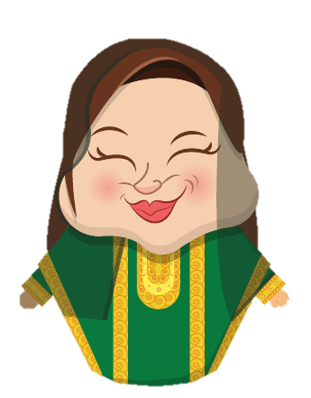
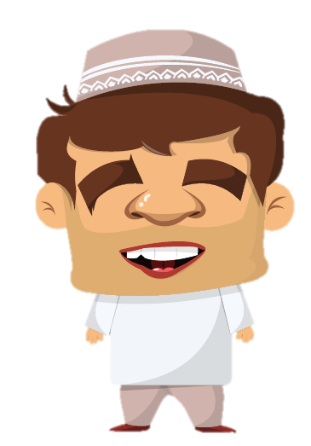





Slide 4
Adjectives
Pedagogical thread:
Ask questions using adjectives. Example: “Where is the street lamp?” — “The street lamp is next to the old man.”
“Is the new car in front of the old house?” …

Slide 5
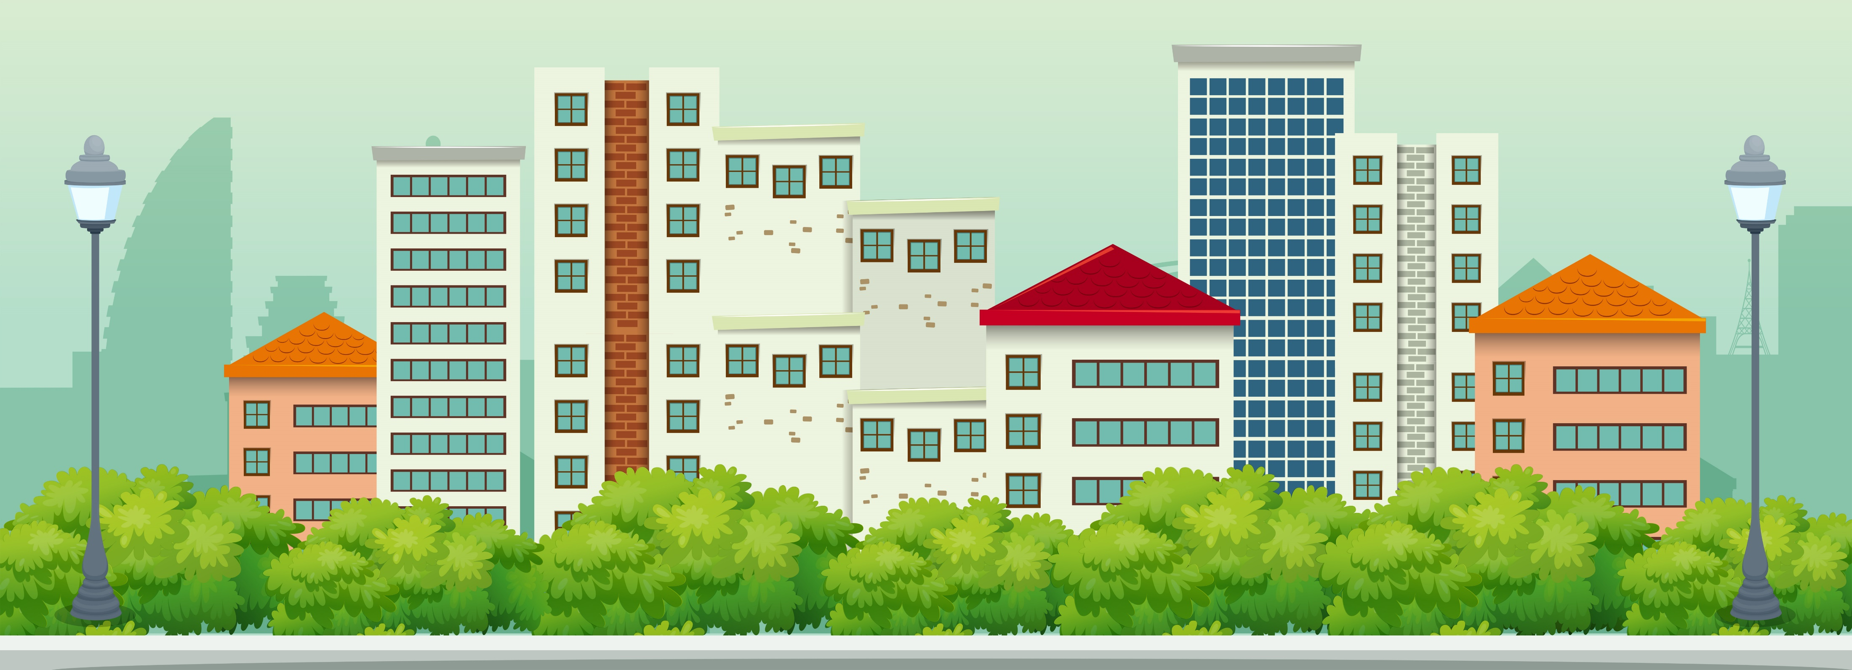






دار جديدة
دار قديمة
اِمْرَأة طويلة فقيرة
اِمْرَأة قصيرة غنيّة
سيّارة جديدة جميلة
سَيّارة قديمة قبيحةُ

Slide 6
صغير | Small (age or volume) | كبير | Big (age or volume)
قصير | Small (size), short. | طويل | Tall (size), long.
ضعيف | Weak | قَوِيّ | Strong
غَنِيّ | Rich | فقير | Poor
قبيح | Ugly | جميل | Beautiful
جديد | New | قديم | Old
مَقْعَد | Seat, bench | مِصْباح | Lamp, street lamp
 |  | سُلَّم | Ladder

Slide 7

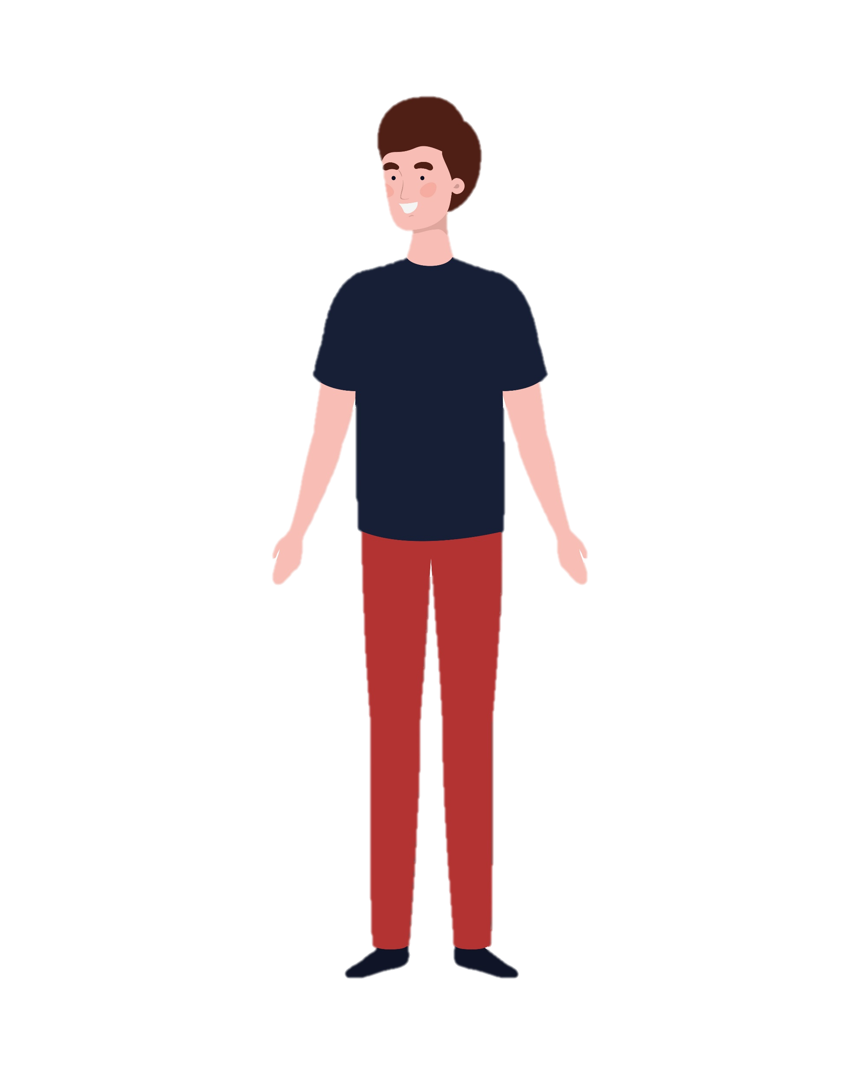
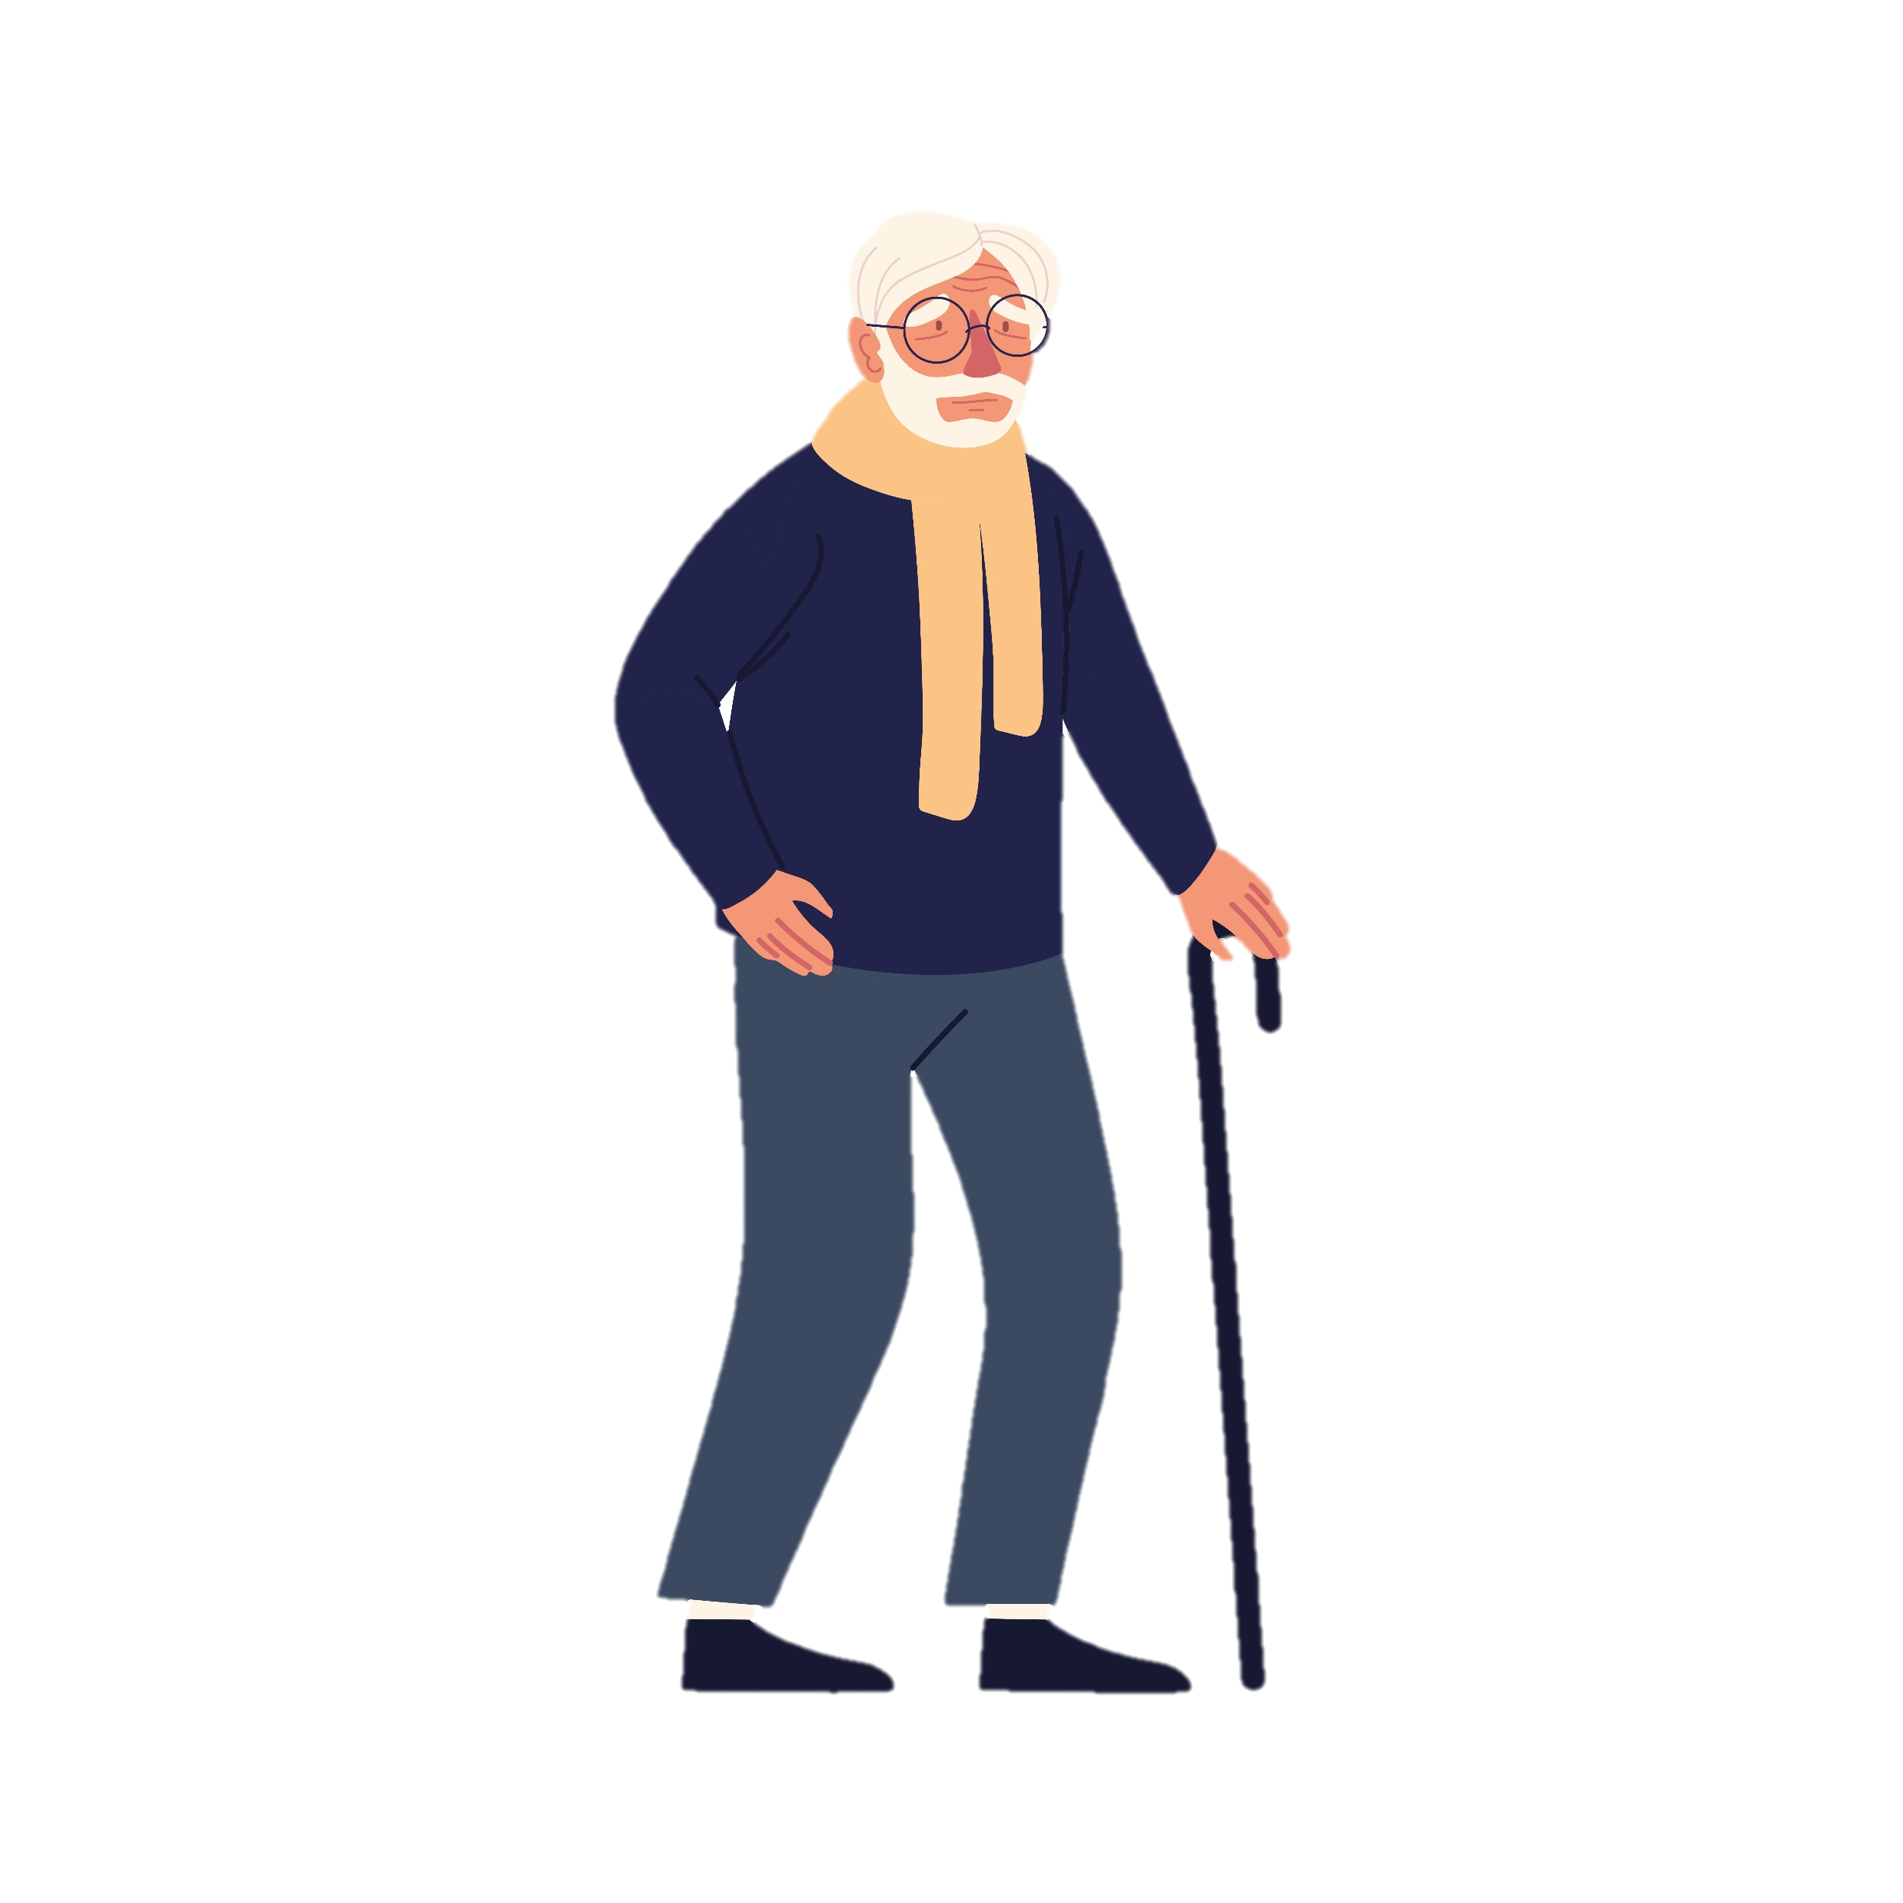
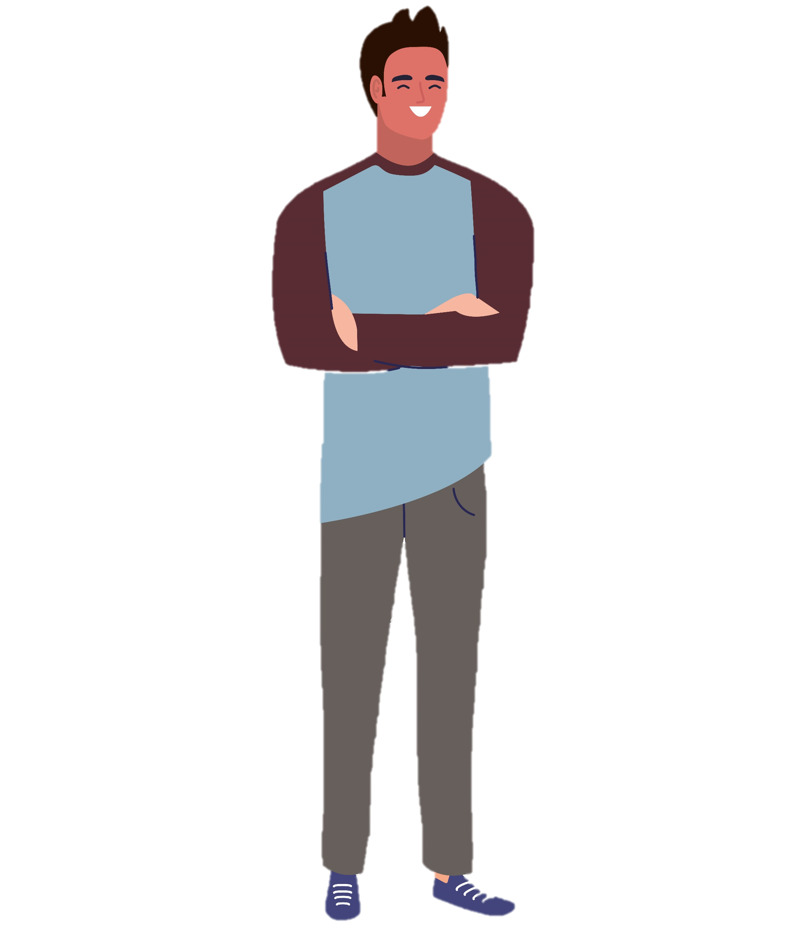


رَجُل طويل
رَجُل كبير
رَجُل قصير
كَلْب قويّ
كَلْبُ ضعيف

Slide 8


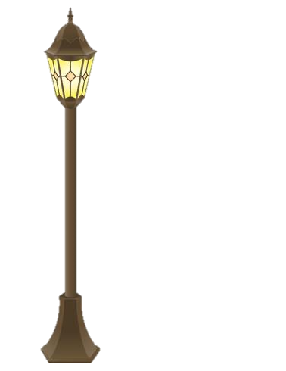




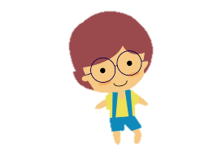



ولد كبير
كَلْب صغير
بنت كبيرة
بنت صغيرة
ولد صغير
كَلْب كبير
سيّارة قصيرة
سيّارة طويلة

Slide 9
Annexation
Pedagogical thread:
Ask questions using adjectives and annexations, then answer. Example: “Is the woman's house new?”

Slide 11



Slide 12













Slide 13








