Slide 1



Document to adapt to the class and to the students' names.
How it works: objects are assigned to the students in the class (write their names). Then questions are asked: “Does Fatou have a pen?”; “Do I (the teacher) have a donkey?”; “Stéphan, do you have a watch?”; etc.
The students then ask each other questions.
The teacher then asks real questions, for example: “Do you have a brother?”; “Does your brother have a car?”;
Second slide for the dual and the plural.
Safar 8: possession

Slide 2

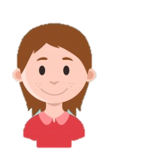

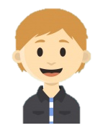
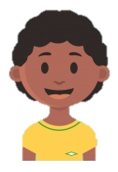




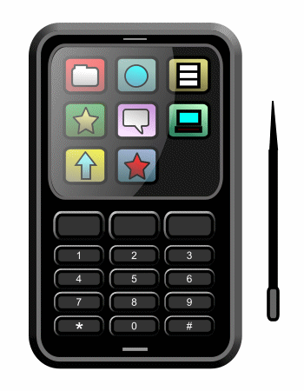



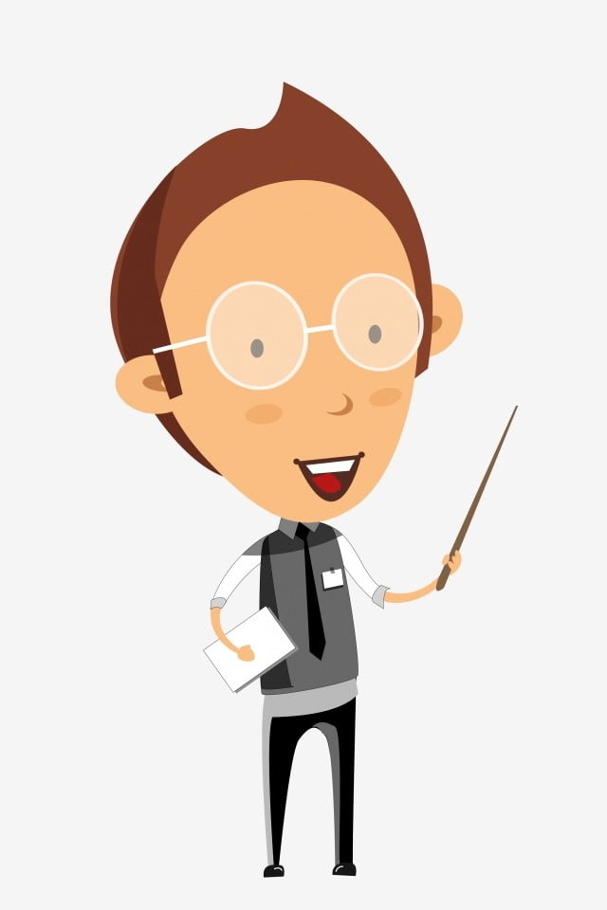
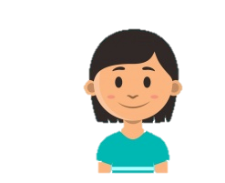
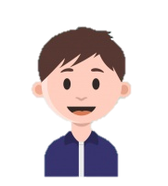
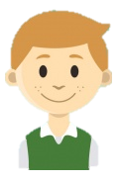
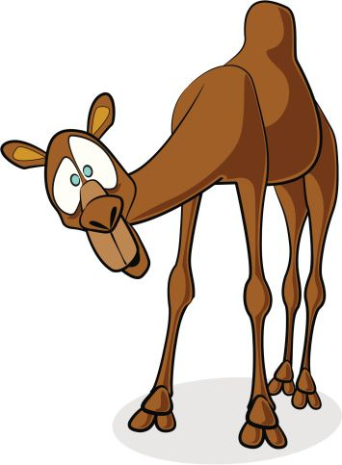


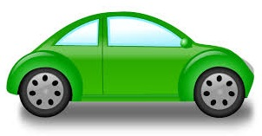


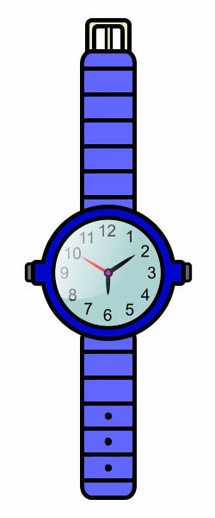
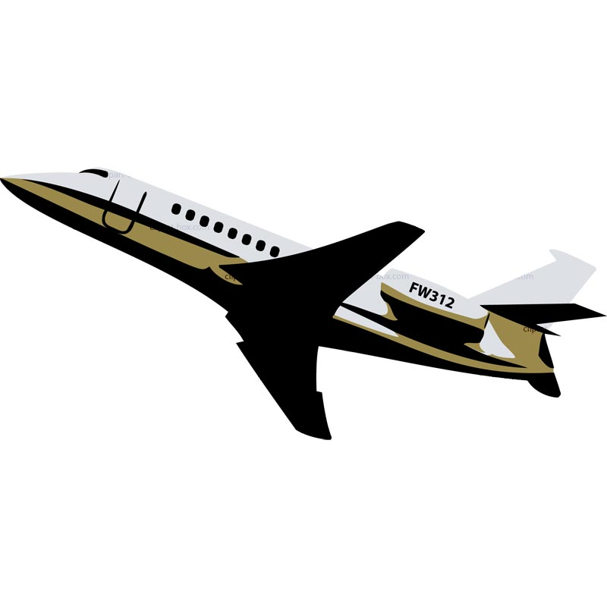
Séverine
فاتِحة
نجاة
Souleymane
Yohan
يَحْيَي
عبد القادِر
Teacher
صالِحة
Rabia
Nels

Slide 3
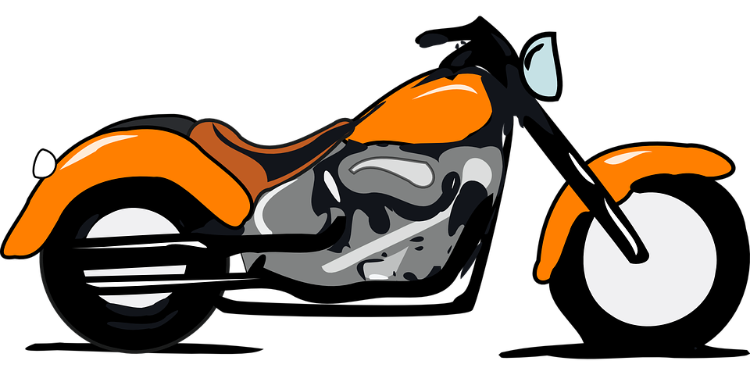
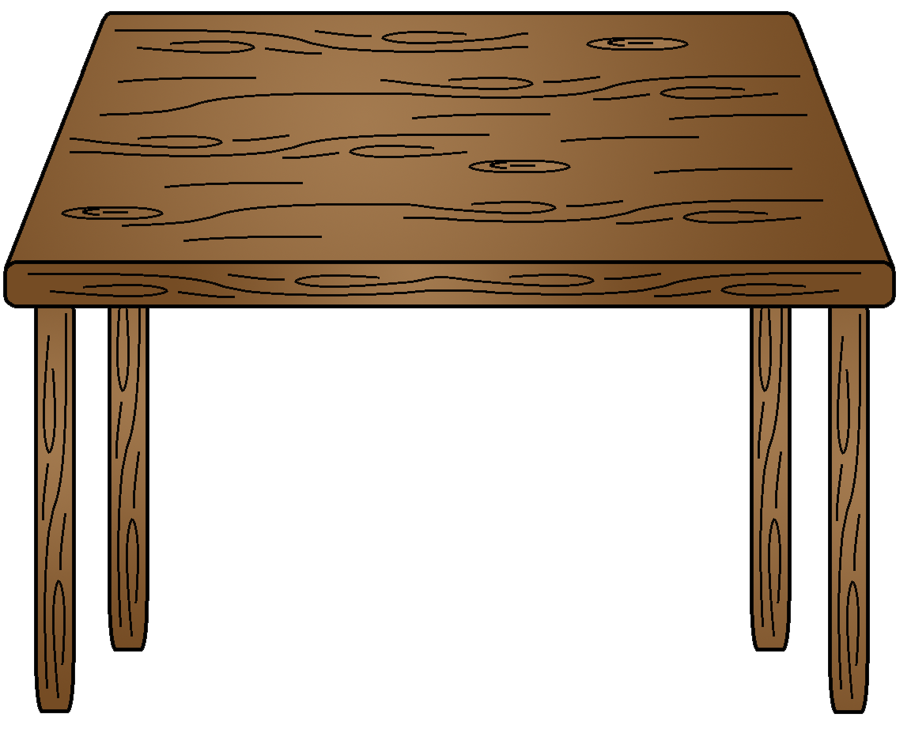
نِلْس صالحة
سليمان
شَهْرَزاد
فاتحة
ثمينة
محمّد
مريم
توما
نجاة

